Slide 1
SMART BUILDING –Control Of HVAC Systems Based On Occupancy Using OpenBuild
By
SHASHANK RAO
KEWAL RAUL
PRANITH KUMAR

Slide 2
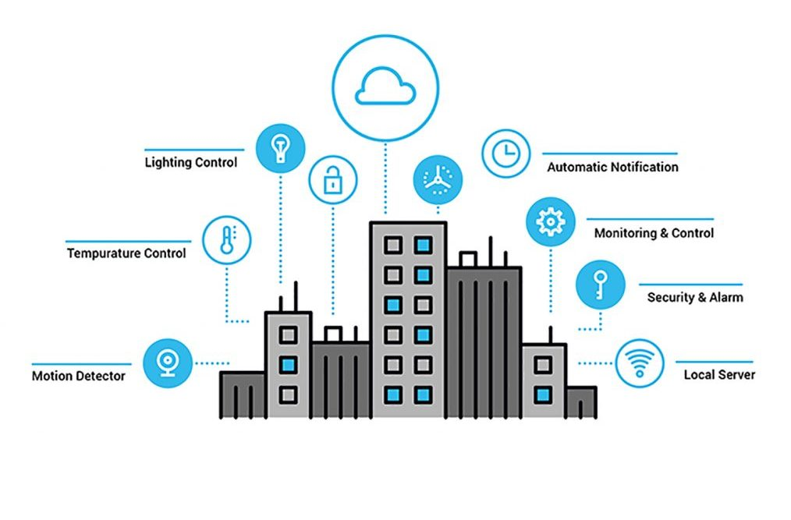
INTRODUCTION
Building automation is the automatic centralized control of a building's heating, ventilation and air conditioning, lighting and other systems through a building management system.
The objectives of building automation are improved occupant comfort, efficient operation of building systems, reduction in energy consumption and operating costs, and improved life cycle of utilities.
As per recent studies, a sizable proportion of total worldwide energy is consumed by buildings
Making buildings more energy efficient is a major step to reduce our energy consumption and carbon footprint to combat global climate change.

Slide 3
OBJECTIVES
To incorporate Occupancy scheduling into OpenBuild infrastructure.
Simulating HVAC & lighting control based on occupancy of people in the building.

Slide 4
BACKGROUND
The Project involves simulation using ;
OpenBuild - a MATLAB toolkit for advanced controller design for a building’s heating ventilation & air conditioning systems.
It helps to co-simulate the building between MATLAB & EnergyPlus.
OpenBuild can directly extract models for the thermodynamics of the building combined with the models of the HVAC system & auxiliary systems which will be simulated on MATLAB.

Slide 5
OpenBuild
OpenBuild is a MATLAB toolkit, providing an integrated environment for design and simulation of advanced controller for Smart Buildings. The capabilities of the toolkit include:
Modelling of HVAC systems in MATLAB
Modelling of electrical components in MATLAB
Design of advanced controllers for smart buildings
Co-simulation of the designed controllers with EnergyPlus

Slide 6

ENERGYPLUS
EnergyPlus™ is a whole building energy simulation program that engineers, architects, and researchers use to model both energy consumption—for heating, cooling, ventilation, lighting and plug and process loads—and water use in buildings. Some of the notable features and capabilities of EnergyPlus include:
Integrated, simultaneous solution of thermal zone conditions and HVAC system response that does not assume that the HVAC system can meet zone loads and can simulate un-conditioned and under-conditioned spaces
User-definable time steps for interaction between thermal zones and the environment; with automatically varied time steps for interactions between thermal zones and HVAC systems. These allow EnergyPlus to model systems with fast dynamics while also trading off simulation speed for precision.
A large number of built-in HVAC and lighting control strategies and an extensible runtime scripting system for user-defined control.

Slide 7
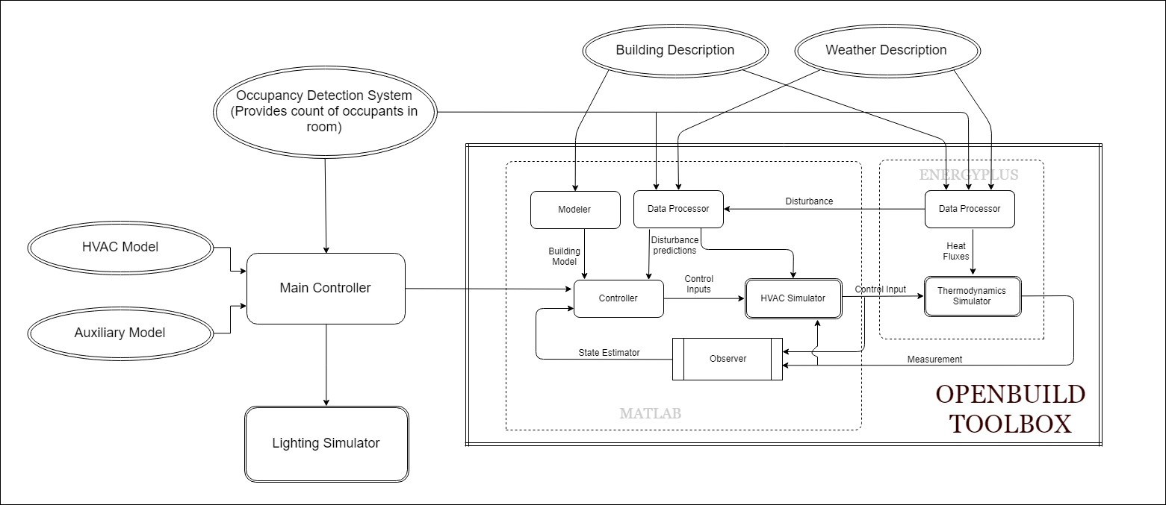
SYSTEM OVERVIEW

Slide 8
EXPERIMENTAL SETUP
Setup OpenBuild
Modify idf description file to integrate Occupancy Scheduling as External Inputs
Simulation Conditions
Using weather file for Long Island, New York
Sample Data used of a week 2018-1-15 to 2018-1-21 starting from Monday to Sunday is used.
Timestep : 60

Slide 9
Building Model Overview
The building has 3 zones with dimensions –
Zone 1 : 40m x 15m x 3.8m
Zone 2 : 15m x 10m x 3.8m
Zone 3 : 40m x 15m x 3.8m
Each zone is defined with a separate People object
Each people object defines a Occupancy Schedule respectively

Slide 10
RESULTS
The simulation was run successfully and we were able to integrate occupancy data with OpenBuild.
We observed how changes in occupancy caused shifts in HVAC system’s operations in a sample building model taken.
The results have been verified with the help of graphs plotted on the basis of output from EnergyPlus and OpenBuild optimizer calculations.

Slide 11
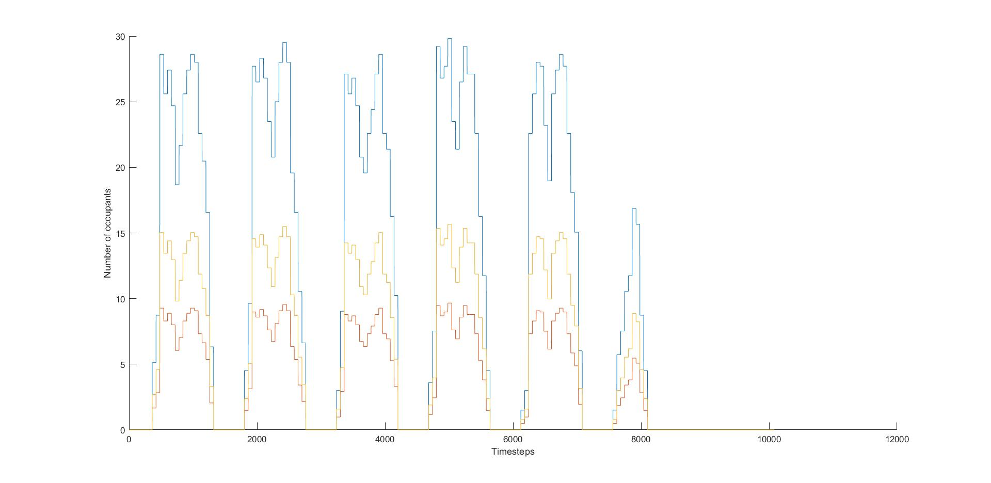
Occupancy vs Time
It depicts the occupancy in all the 3 zones throughout the week.
On weekdays the occupancy is at peak during day hours with some dip during noon hours. Occupancy is zero over night.
On Saturday, occupancy is pretty low throughout the day.
On Sunday, the occupancy is set to zero.

Slide 12
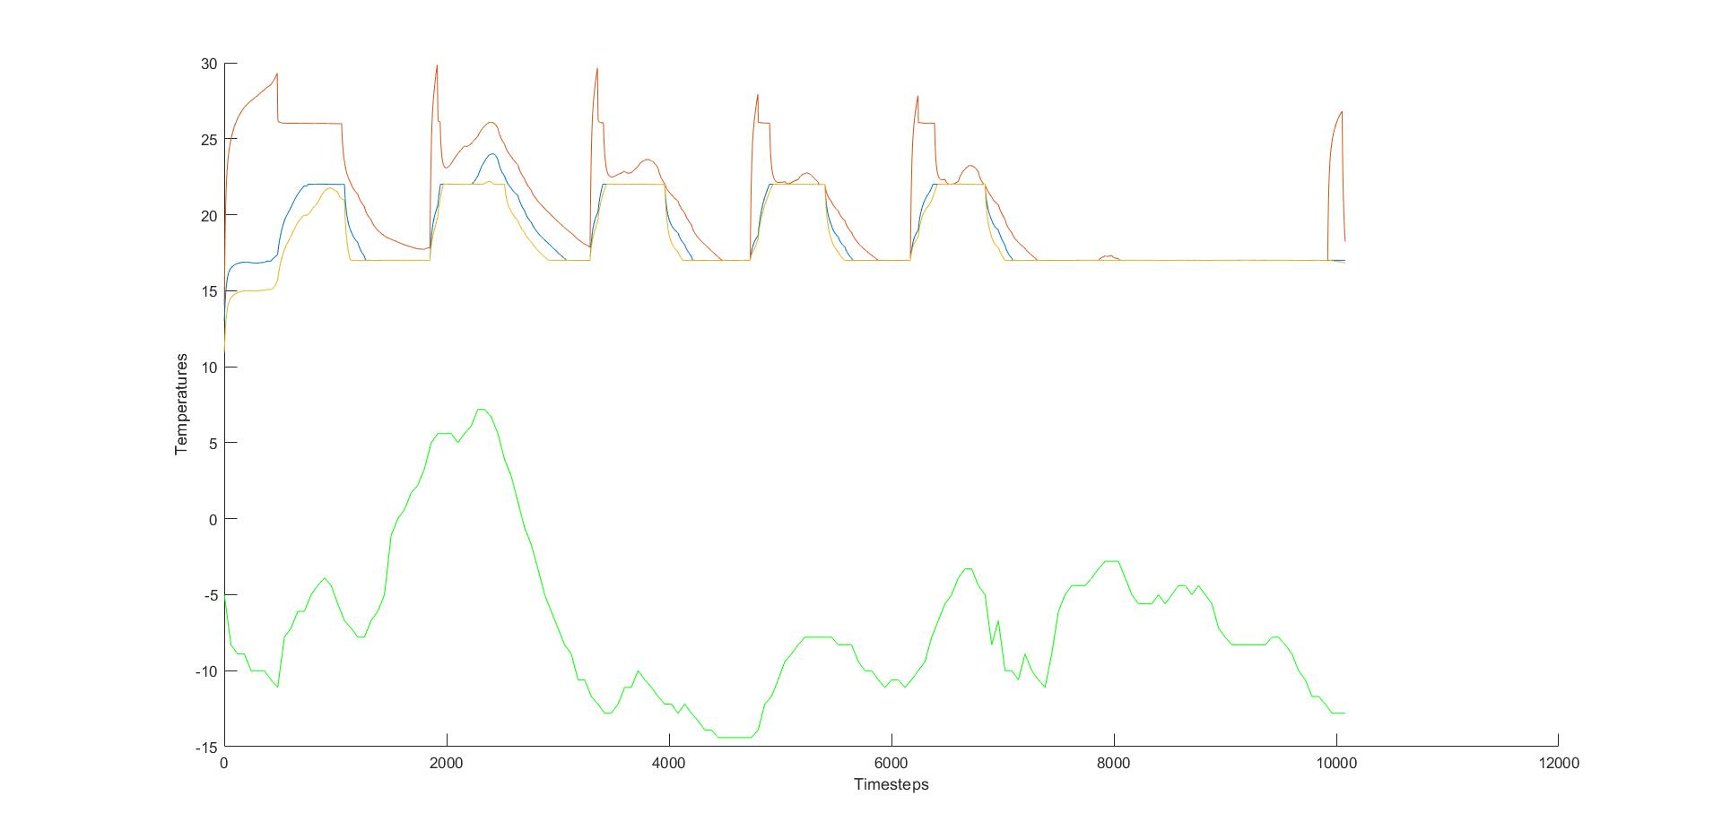
Temperature vs Time
The line graph in green depicts the outside temperature
The other 3 line graphs state the temperature in the respective zones of the building.
The temperature in the zones is maintained warm throughout.

Slide 13
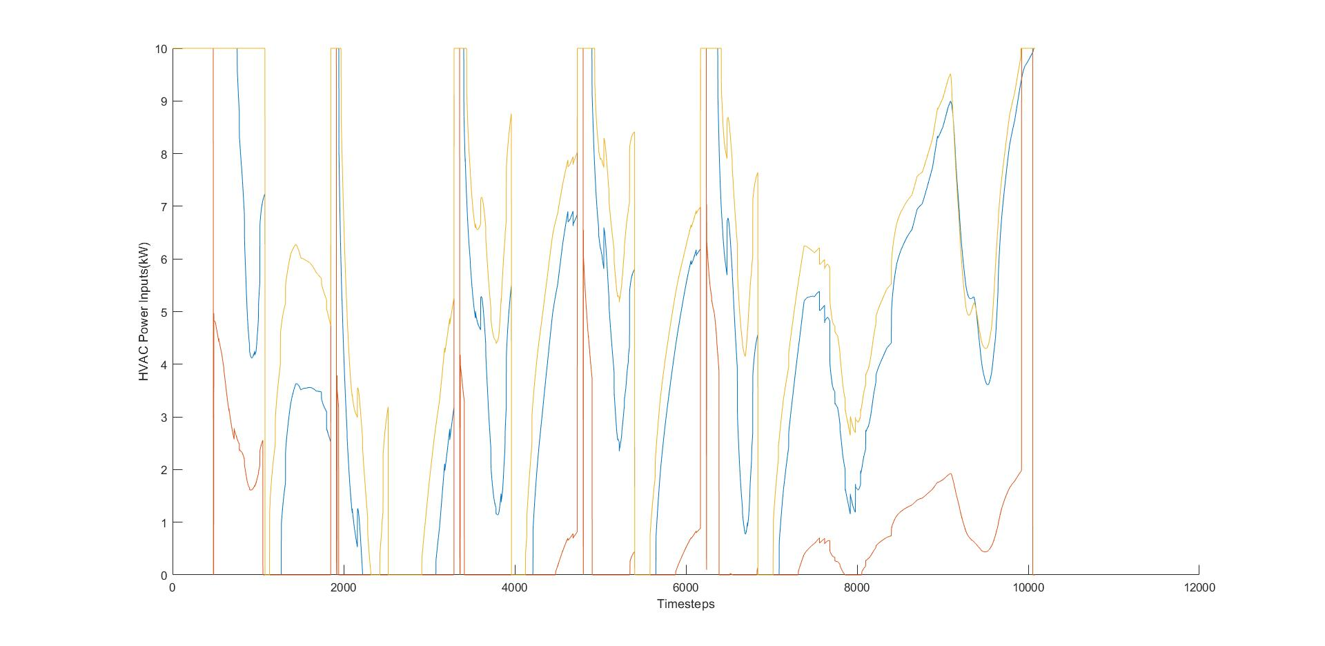
HVAC Power vs Time
The graph depicts the power consumed by the HVAC across all the 3 zones over a period of week.

Slide 14
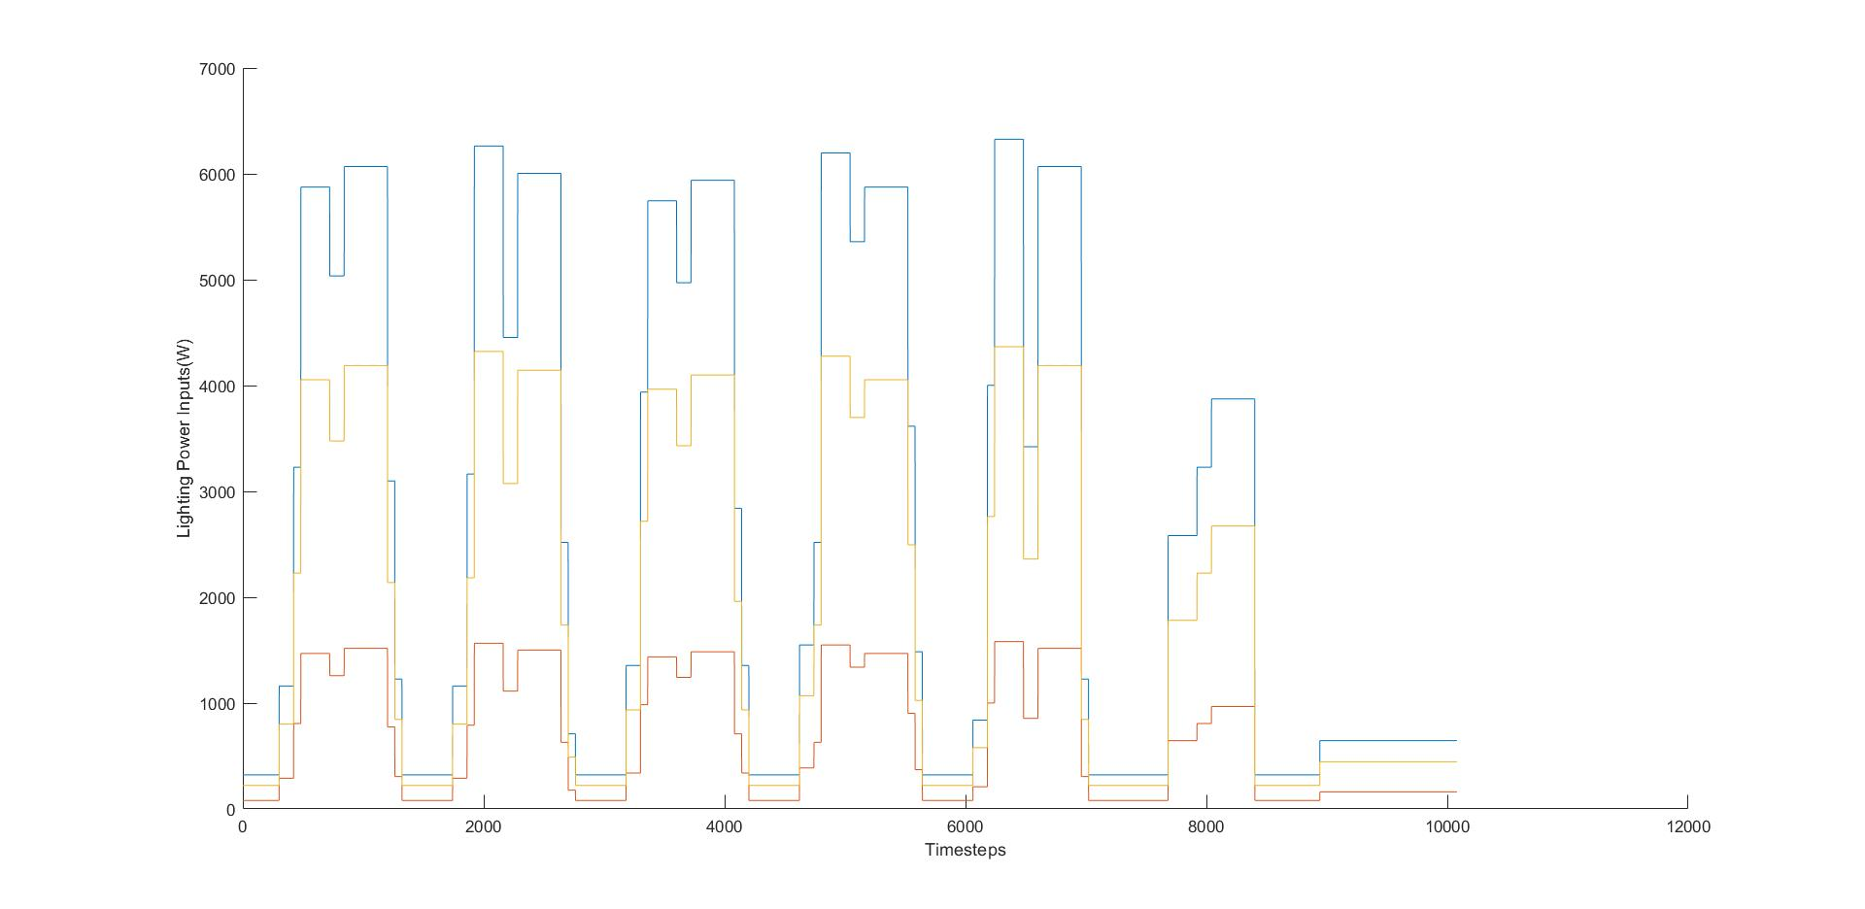
Lighting Power vs Time
It illustrates the power consumed by lighting equipment in the 3 zones respectively.
It works in sync with the occupancy in the respective zone

Slide 15
THANK YOU

